Slide 1
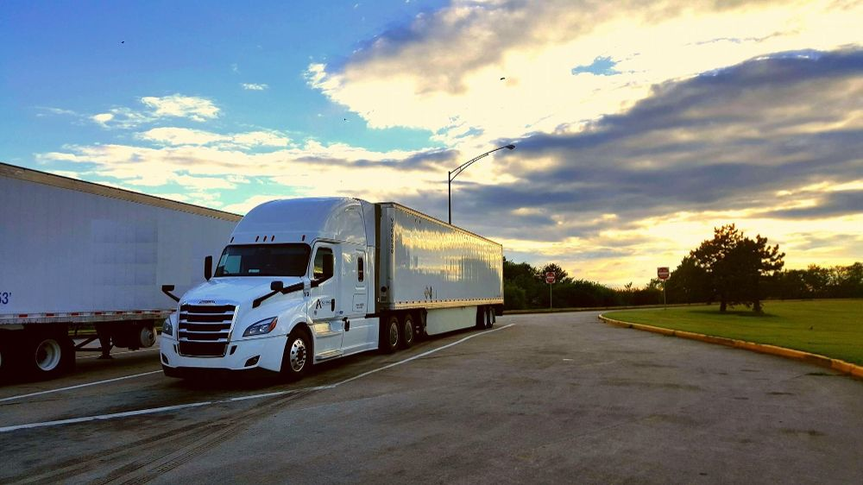
RRGT
MOBILE APPLICATION DEVELOPMENT
PROJECT NAME:
TRANSPORT SERVICE MANAGEMENT

Slide 2
Booking Agency System for transport
CONTENTS
Booking of Vehicle for Transport
Driver Information
Vehicle Information
Update Review
Highly Rated Driver

Slide 3
BUSINESS CASE
User of this app is Owner of Agency
Agency which does the transportation
The basic idea behind this project is to provide the transportation agencies with better and efficient way to organize their system and service .This app can help them to manage the usage of money and can help them with their profits and losses.
The app will also help the driver to get better employment opportunities as they will be provided with service on regular basis .In a particular agency, the app will be handled by the one agent or by the owner of the company .
This will also allow the users who are travelling, to rate the drivers on the basis of service provided and also the reviews about the service.
Thus, the app will help the agency with their account section management and the other users will be able to find the best transportation facility for them and the best driver.

Slide 4
Mobile platform
This app is developed for the android based mobile phones.
The ionic framework is used for the development of this app with the programming languages Javascript, HTML, CSS.
Ionic is the open-source SDK for hybrid mobile app development. Ionic provides tools and services for developing hybrid mobile apps.

Slide 5
ASSUMPTIONS
Using the app the Owner books the vehicle for tranportation on behalf of the customer according to the his need.
Also he will be allotted the best available vehicle according to the weight he wanted to transport.
Also with the help of reviews he can choose the driver with higher ratings. He can give reviews about that driver for further improvement of system.

Slide 6
SYSTEM DISCRIPTION
The purpose of Transportation Agency System is to provide the ease to booking agency head to maintain all the records of driver also maintains the review so that he can suggest the highly rated driver to his client.
According to client’s need depending upon weight of goods he wanted to transport the agency will decide which vehicle should be allotted to him and what will be the fare.

Slide 7
Mobile app functionality
The first page of the app is the login page where the user/owner of the company will login; where the username and password is predefined for the particular company .After the successful login the app allow the user with two options: Booking and Driver Information.
After selecting booking option the user will be able to book the driver and vehicle on the basis of their ratings. And in the Driver info section the user will be able to check the reviews of the driver and will also be able to rate the driver.

Slide 8
CONTENTS OF APP INCLUDE
1.Driver Information:
Which includes driver’s
1.Age
2.Contact number
3. Address
2.Vehicle Information:
Which includes vehicle’s
1.Capacity
2.Number plate
3.Name of Vehicle
3.Review:
Includes the ratings of Driver given by clients.
And the reviews which are updated time to time.

Slide 9
4.Booking
Booking of vehicle includes
1.Checking of fares.
2.Checking of Availability of Vehicle.
5.Highly Rated Driver
It includes sorted list of drivers based on reviews gives by clients

Slide 10
5.Application Design
LOGIN
BOOKING
USER NAME
DRIVER
PASSWORD

Slide 11
BOOKING
SMALL
MEDIUM
INPUT
WEIGHT
LARGE
DRIVERS FARE
DISPLAY FARE
*ACC TO VEHICLE
*DISTANCE
*NIGHT FARE *CHARGES
CHECK
BOOK
DISPLAY AVAILABILITY

Slide 12
DRIVER
*AGE
*CONTACT NO.
*NAME
DRIVER INFO
UPDATE
REVIEW
RATINGS
HIGHLY RATED DRIVER
SORTED LIST OF DRIVERS

Slide 13
BACK END FOR THIS APP
While the front-end talks about the user interface, user interaction, and how the content is presented, the back- end handles the business logic, data storage, and security.
The back-end is the server part of the app. The back-end will mostly store the data of the drivers and the number of vehicles available .This will also keep the record of the account section like amount of money spent on the maintenance of the vehicles and the salary distribution of the drivers. And will also handle the profit and loss of the company.

Slide 14
PROBLEMS THAT CAN BE SOLVED WITH THIS APPLICATION
Necessity is the mother of all inventions and the most successful ventures turn out to be the one that solves its end user’s problems.
This app will do the same work by providing the agencies with fewer employees to manage the account section.
This app will able to do the work which is done by all these employees. So, helps the company with less investment on the employee’s salary and invest it more on the transportation service and the driver’s salary.

Slide 15
Ideas Not Implemented:

